Slide 1

PROJECT ON
STUDENT MANAGEMENT SYSTEM
NAME: Pothula Arun Kumar
BATCH NO: 489
BRANCH: JNTU

Slide 2
Project Overview
A console-based Student Management System developed using Python.
Stores and manages student records efficiently.
Supports CRUD operations (Create, Read, Update, Delete).
Data persistence using file handling.

Slide 3
Objectives
Manage student information easily.
Perform operations like add, search, update, and delete.
Store data permanently using files.
Provide a simple menu-driven interface.

Slide 4
Key Features
Add new students.
View all students.
Search student by roll number.
Update student marks.
Delete student record.
Automatic data saving.

Slide 5
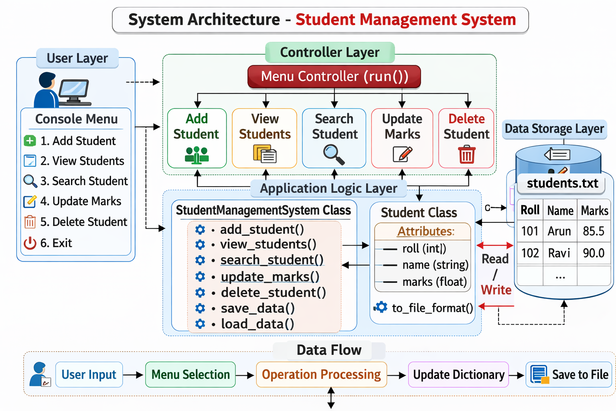
System Architecture

Slide 6
Student Class
Stores roll number, name, and marks.
Constructor initializes student details.
to_file_format() converts data into file format.
Used for structured data storage.

Slide 7
StudentManagementSystem Class
Handles all operations.
Maintains students in a dictionary.
Loads data from file at start.
Saves data before exiting.

Slide 8
Main Functions
load_data() → Reads student data from file.
save_data() → Writes data to file.
add_student() → Adds new record.
view_students() → Displays records.

Slide 9
Additional Functions
search_student() → Finds student by roll number.
update_marks() → Updates marks.
delete_student() → Removes student.
run() → Controls program execution.

Slide 10
Program Workflow
Program starts and loads data.
Displays menu options.
User selects operation.
System performs action.
Data saved before exit.

Slide 11
Advantages
Simple and easy to use.
File-based data persistence.
Modular code structure.
Beginner-friendly Python project.

Slide 12
Conclusion
Simple and easy to use.
File-based data persistence.
Modular code structure.
Beginner-friendly Python project.

Slide 13

GitHub: Arun1859/StudentManagementSystem: StudentManagementSystem
Linkedin: Arun Kumar P | LinkedIn
THANK YOU

